Slide 1
CSP571 Data Preparation and Analysis
Lecture 3. Linear Regression. Error estiomation
Oleksandr Narykov
onarykov@iit.edu

Slide 2
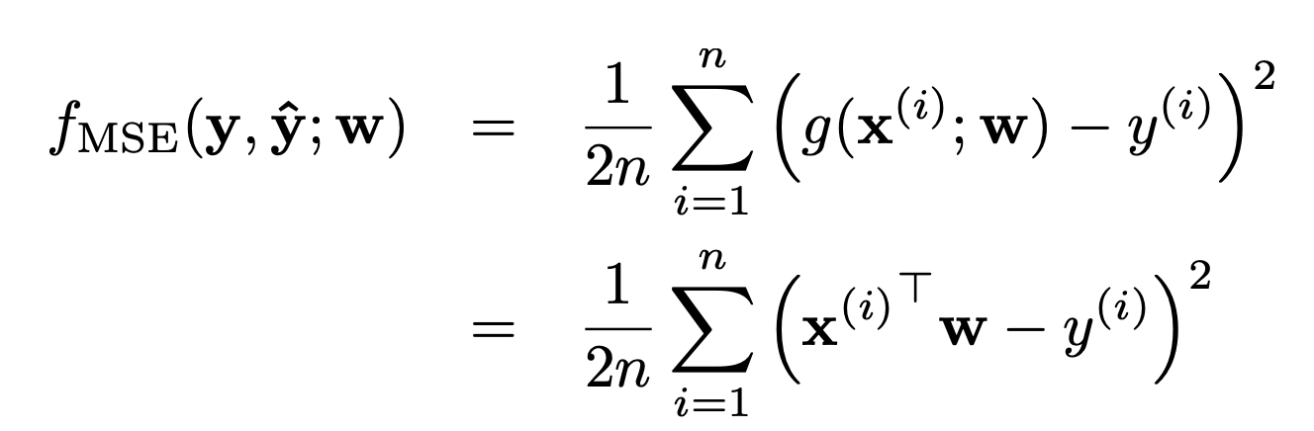
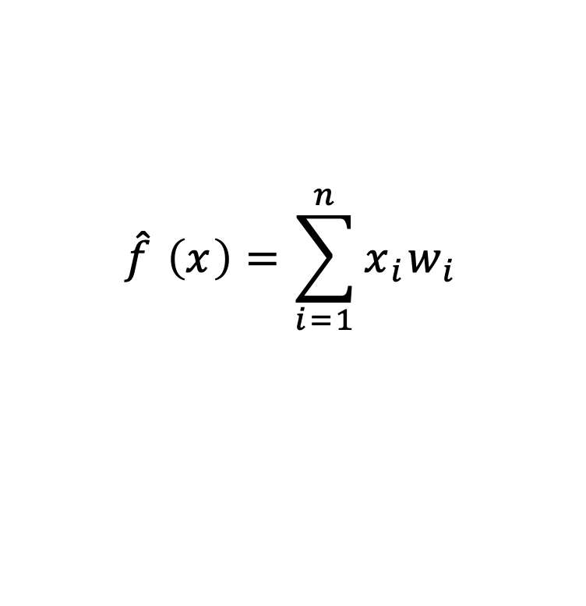
Linear Regression
$$\hat{f} \left(x\right)=\sum_{i=1}^{n}{x_{i}w_{i}}$$
10

Slide 3
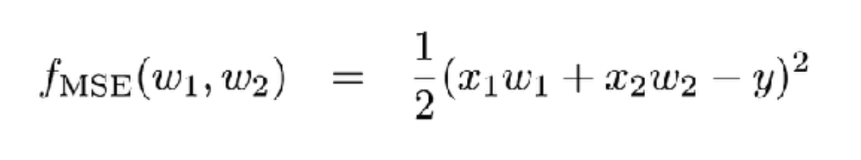
Linear Regression. 2D case
10

Slide 4
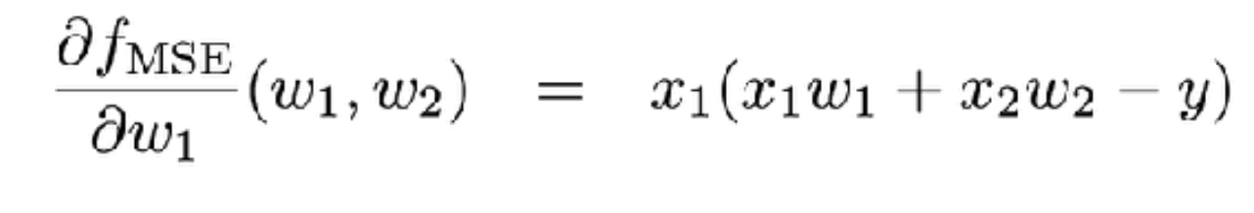
Linear Regression. 2D case
10

Slide 5
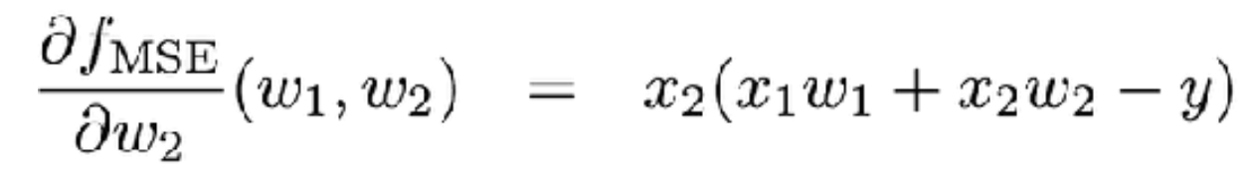
Linear Regression. 2D case
10

Slide 6
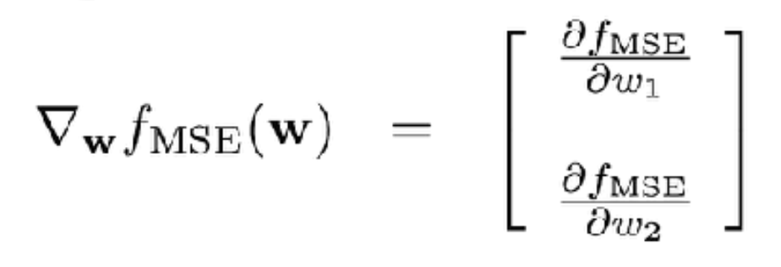
Linear Regression. 2D case
10

Slide 7
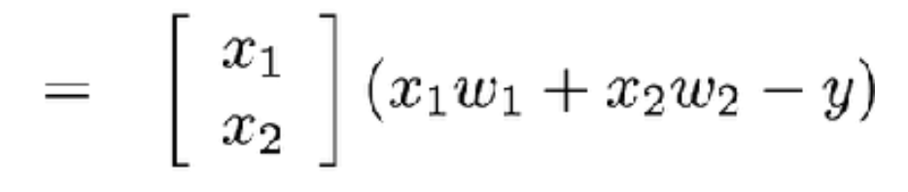
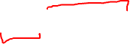
Linear Regression. 2D case
10

Slide 8
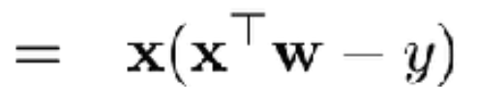
Linear Regression. 2D case
10

Slide 9
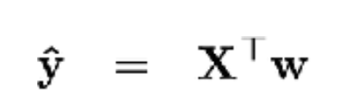
Linear Regression. 2D case
10

Slide 10
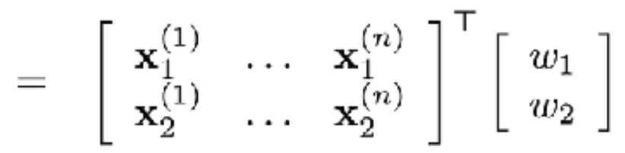
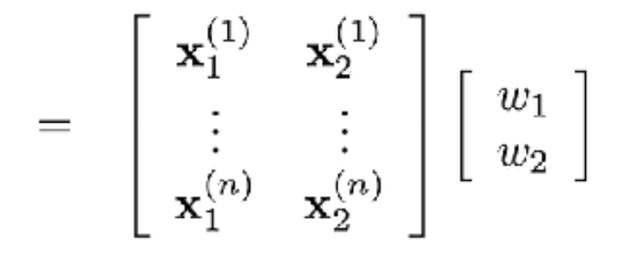
Linear Regression. 2D case
10

Slide 11
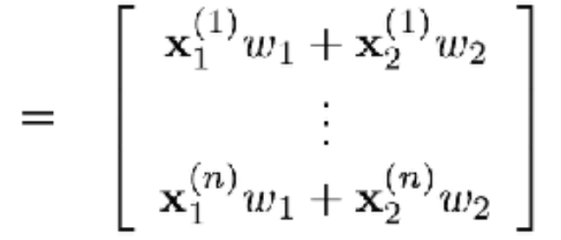
Linear Regression. 2D case
10

Slide 12
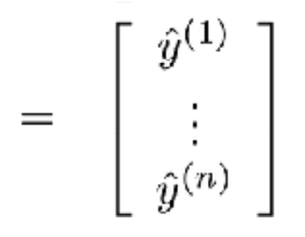
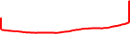
Linear Regression. 2D case
10

Slide 13
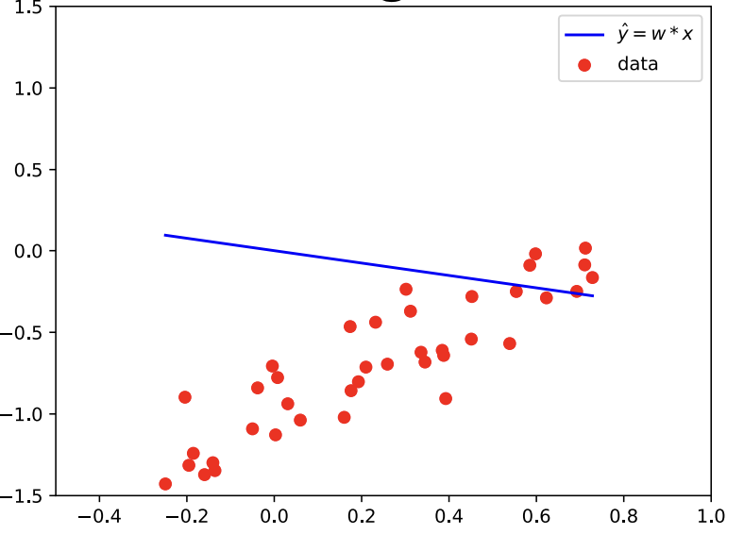
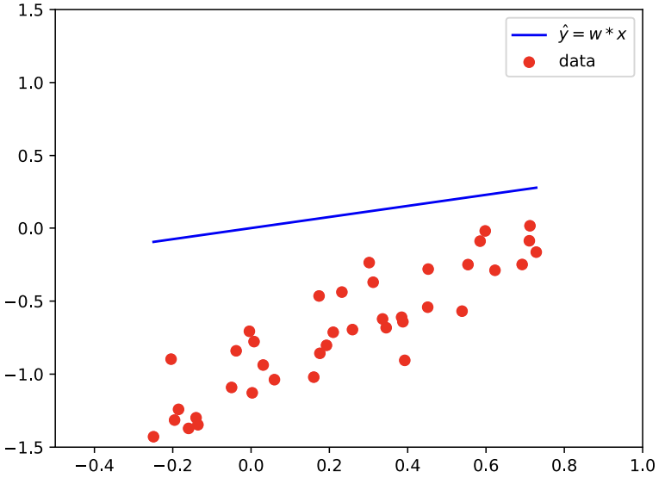
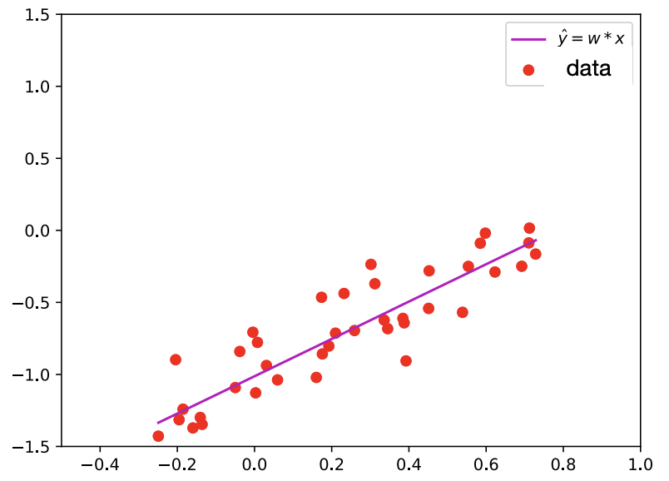
Linear Regression. Learning a Model

Slide 14
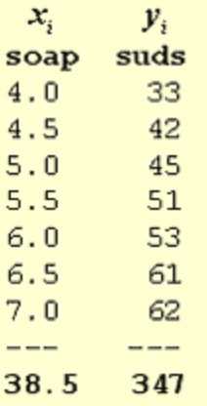
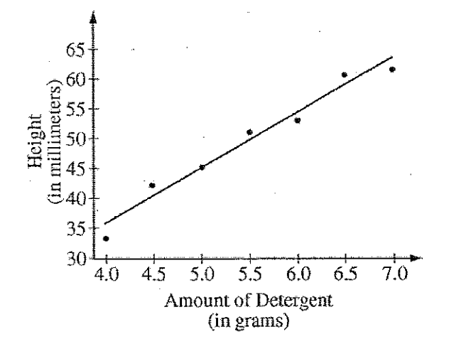
Linear Regression. Soap
10

Slide 15
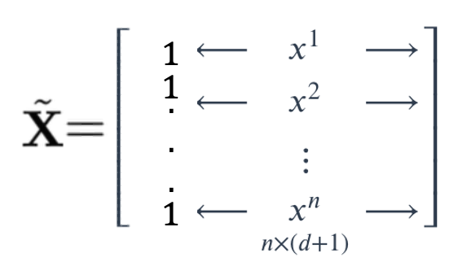
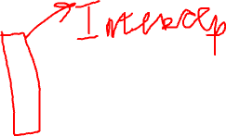
Linear Regression. Soap
10

Slide 16
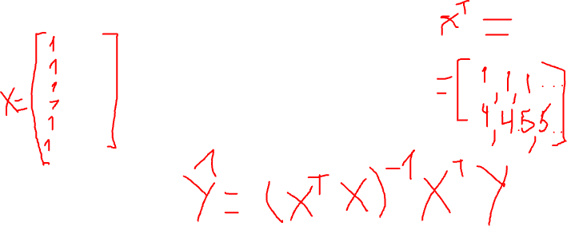
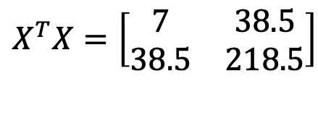
Linear Regression. Soap
$$X^{T}X=\left[\begin{matrix}7 & 38.5 \\ 38.5 & 218.5\end{matrix}\right]$$
10

Slide 17
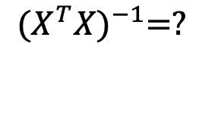
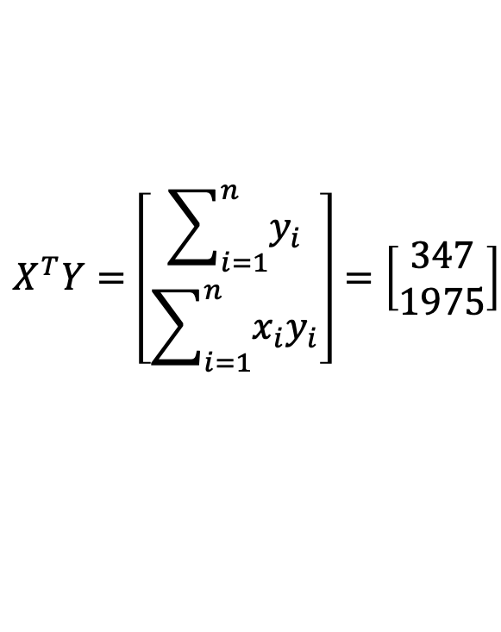
Linear Regression. Soap
$$X^{T}X=\left[\begin{matrix}7 & 38.5 \\ 38.5 & 218.5\end{matrix}\right]$$
$$X^{T}Y=\left[\begin{matrix}\sum_{i=1}^{n}{y_{i}} \\ \sum_{i=1}^{n}{{x_{i}y}_{i}}\end{matrix}\right]=\left[\begin{matrix}347 \\ 1975\end{matrix}\right]$$
$${(X^{T}X)}^{−1}=?$$
10

Slide 18
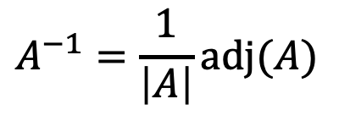
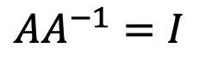
Linear Algebra Recap
$$AA^{−1}=I$$
$$A^{−1}=\frac{1}{\left|A\right|}adj(A)$$
10

Slide 19
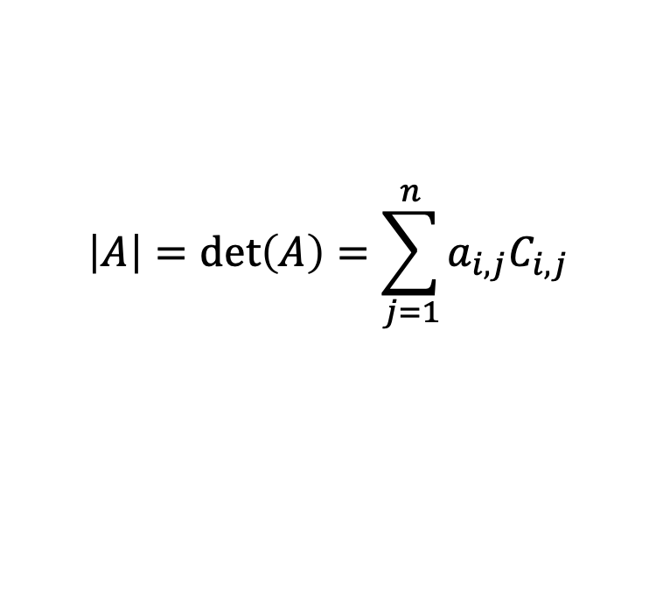
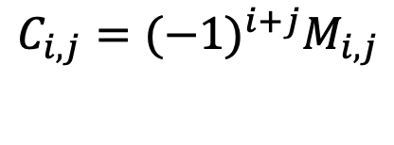
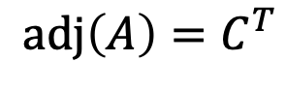
Linear Algebra Recap
$$AA^{−1}=I$$
$$A^{−1}=\frac{1}{\left|A\right|}adj(A)$$
$$adj\left(A\right)=C^{T}$$
$$C_{i,j}={(−1)}^{i+j}M_{i,j}$$
$$\left|A\right|=\det\left(A\right)=\sum_{j=1}^{n}{a_{i,j}C_{i,j}}$$
10

Slide 20
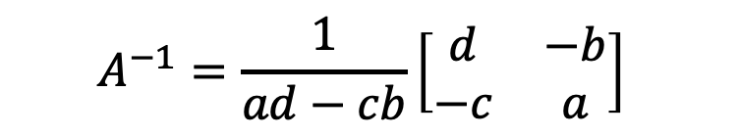
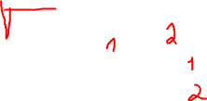

Linear Algebra Recap
$$AA^{−1}=I$$
$$A^{−1}=\frac{1}{\left|A\right|}adj(A)$$
$$adj\left(A\right)=C^{T}$$
$$C_{i,j}={(−1)}^{i+j}M_{i,j}$$
$$\left|A\right|=\det\left(A\right)=\sum_{j=1}^{n}{a_{i,j}C_{i,j}}$$
$$A=\left[\begin{matrix}a & b \\ c & d\end{matrix}\right]$$
$$A^{−1}=\frac{1}{ad−cb}\left[\begin{matrix}d & −b \\ −c & a\end{matrix}\right]$$
10

Slide 21
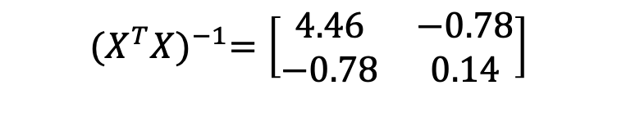
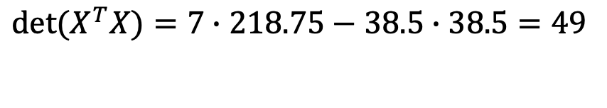
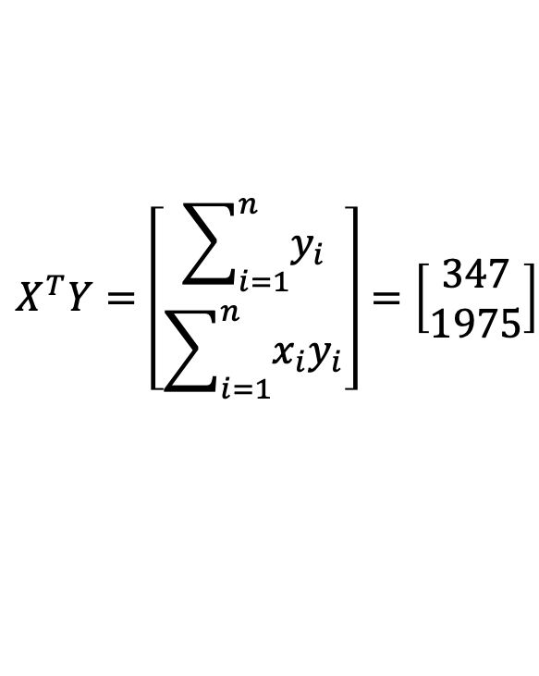
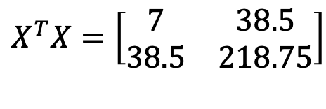
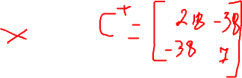
Linear Regression. Soap
$$X^{T}X=\left[\begin{matrix}7 & 38.5 \\ 38.5 & 218.75\end{matrix}\right]$$
$$\det{(X^{T}X)}=7∙218.75−38.5∙38.5=49$$
$$X^{T}Y=\left[\begin{matrix}\sum_{i=1}^{n}{y_{i}} \\ \sum_{i=1}^{n}{{x_{i}y}_{i}}\end{matrix}\right]=\left[\begin{matrix}347 \\ 1975\end{matrix}\right]$$
$${(X^{T}X)}^{−1}=\left[\begin{matrix}4.46 & −0.78 \\ −0.78 & 0.14\end{matrix}\right]$$
10
Notes:
[218.75, -38.5]
[-38.5, 7]

Slide 22
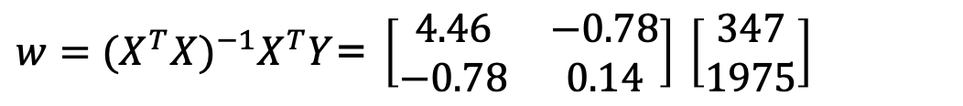
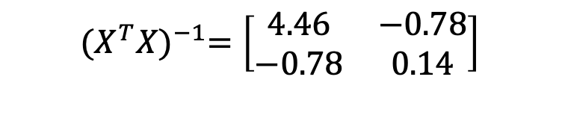
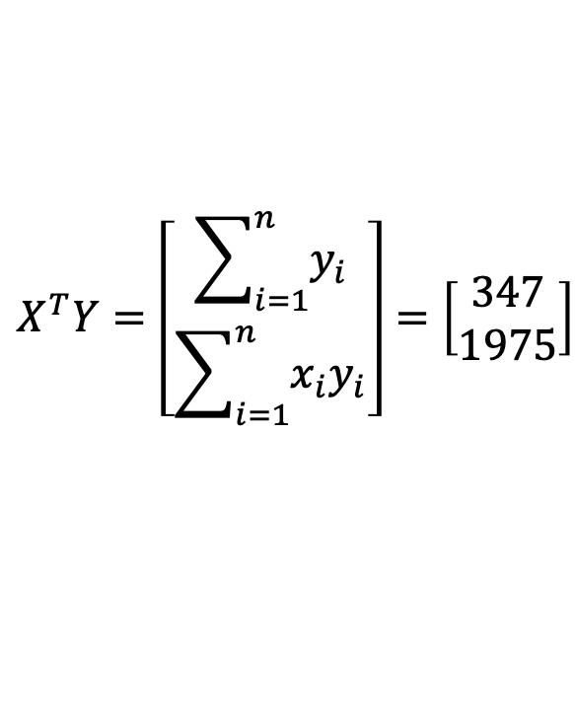
Linear Regression. Soap
$$X^{T}Y=\left[\begin{matrix}\sum_{i=1}^{n}{y_{i}} \\ \sum_{i=1}^{n}{{x_{i}y}_{i}}\end{matrix}\right]=\left[\begin{matrix}347 \\ 1975\end{matrix}\right]$$
$${(X^{T}X)}^{−1}=\left[\begin{matrix}4.46 & −0.78 \\ −0.78 & 0.14\end{matrix}\right]$$
${w=(X^{T}X)}^{−1}X^{T}Y$= $\left[\begin{matrix}4.46 & −0.78 \\ −0.78 & 0.14\end{matrix}\right]$ $\left[\begin{matrix}347 \\ 1975\end{matrix}\right]$
10
Notes:
3

Slide 23
Linear Regression. Soap
$$X^{T}Y=\left[\begin{matrix}\sum_{i=1}^{n}{y_{i}} \\ \sum_{i=1}^{n}{{x_{i}y}_{i}}\end{matrix}\right]=\left[\begin{matrix}347 \\ 1975\end{matrix}\right]$$
$${(X^{T}X)}^{−1}=\left[\begin{matrix}4.46 & −0.78 \\ −0.78 & 0.14\end{matrix}\right]$$
${w=(X^{T}X)}^{−1}X^{T}Y$= $\left[\begin{matrix}4.46 & −0.78 \\ −0.78 & 0.14\end{matrix}\right]$ $\left[\begin{matrix}347 \\ 1975\end{matrix}\right]=\left[\begin{matrix}−2.67 \\ 9.51\end{matrix}\right]$
10
Notes:
3

Slide 24
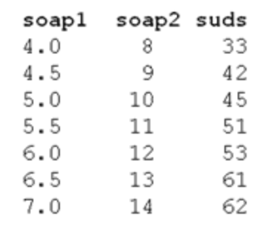

Linear Regression. Numerical Stability
$$X^{T}Y=\left[\begin{matrix}\sum_{i=1}^{n}{y_{i}} \\ \sum_{i=1}^{n}{{x_{i}y}_{i}}\end{matrix}\right]=\left[\begin{matrix}347 \\ 1975\end{matrix}\right]$$
$${(X^{T}X)}^{−1}=\left[\begin{matrix}4.46 & −0.78 \\ −0.78 & 0.14\end{matrix}\right]$$
$${(X^{T}X)}^{−1}=?$$
10
Notes:
3

Slide 25
Linear Regression. Numerical Stability
$$X^{T}Y=\left[\begin{matrix}\sum_{i=1}^{n}{y_{i}} \\ \sum_{i=1}^{n}{{x_{i}y}_{i}}\end{matrix}\right]=\left[\begin{matrix}347 \\ 1975\end{matrix}\right]$$
$${(X^{T}X)}^{−1}=\left[\begin{matrix}4.46 & −0.78 \\ −0.78 & 0.14\end{matrix}\right]$$
$${(X^{T}X)}^{−1}=?$$
In practice, pseudoinverse is used
10
Notes:
3

Slide 26
Regularization

Slide 27
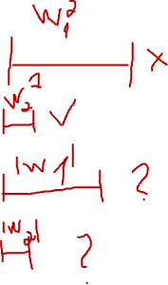
Regularization
L₂ regularization
Minimize squared-loss + L₂ penalty
Also called Ridge regression
L₁ regularization
Minimize squared-loss + L₁ penalty
Also called Lasso regression
11
Notes:
Square-shaped constraints
Rhombus-shaped constraints

Slide 28
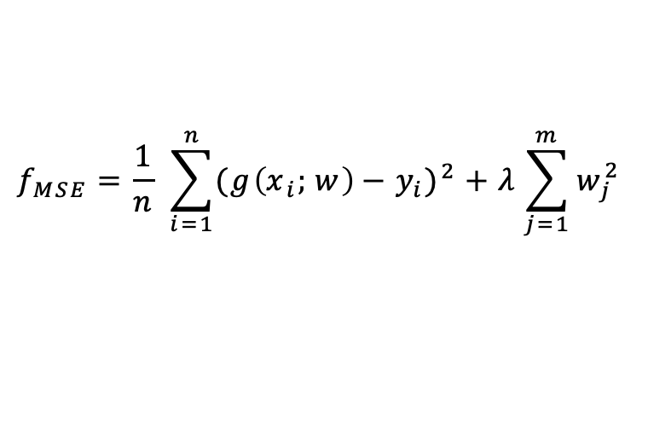
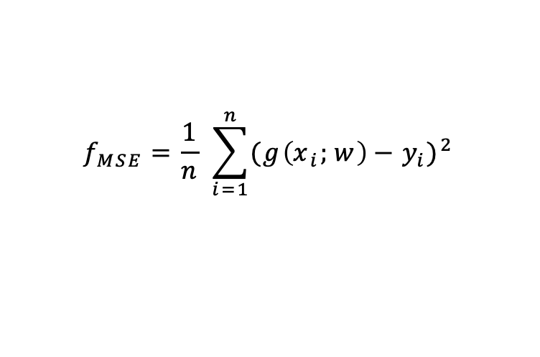
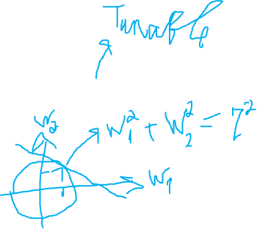
Regularization
$$f_{MSE}=\frac{1}{n} \sum_{i=1}^{n}{{({g\left(x_{i};w\right)−y}_{i})}^{2}}$$
L₂ regularization
$$f_{MSE}=\frac{1}{n} \sum_{i=1}^{n}{{({g\left(x_{i};w\right)−y}_{i})}^{2}}+λ\sum_{j=1}^{m}{w_{j}^{2}}$$
11

Slide 29
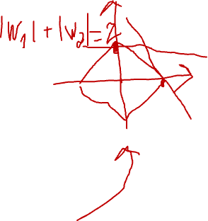
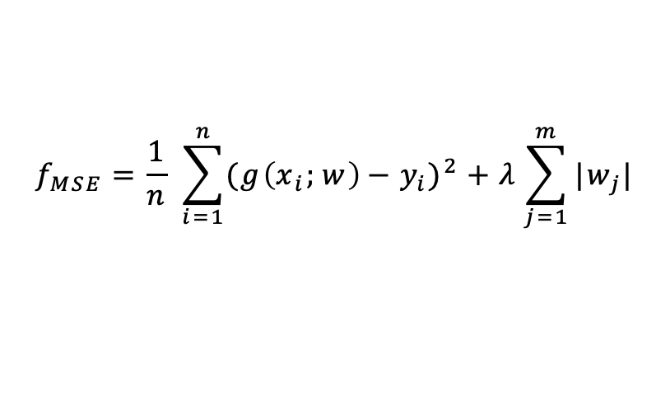
Regularization
$$f_{MSE}=\frac{1}{n} \sum_{i=1}^{n}{{({g\left(x_{i};w\right)−y}_{i})}^{2}}$$
L₂ regularization
$$f_{MSE}=\frac{1}{n} \sum_{i=1}^{n}{{({g\left(x_{i};w\right)−y}_{i})}^{2}}+λ\sum_{j=1}^{m}{w_{j}^{2}}$$
L₁ regularization
$$f_{MSE}=\frac{1}{n} \sum_{i=1}^{n}{{({g\left(x_{i};w\right)−y}_{i})}^{2}}+λ\sum_{j=1}^{m}{|w_{j}|}$$
11

Slide 30
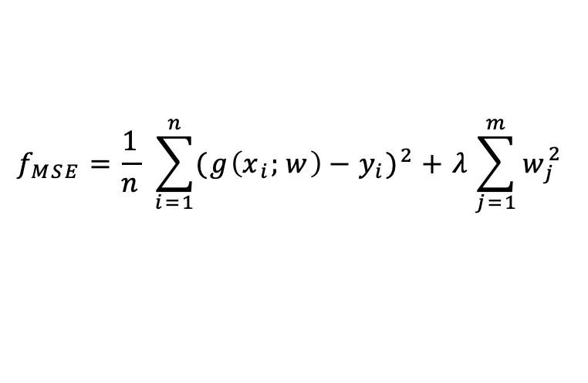
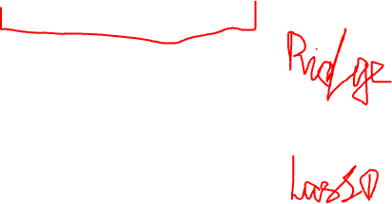



Regularization
$$f_{MSE}=\frac{1}{n} \sum_{i=1}^{n}{{({g\left(x_{i};w\right)−y}_{i})}^{2}}$$
L₂ regularization
$$f_{MSE}=\frac{1}{n} \sum_{i=1}^{n}{{({g\left(x_{i};w\right)−y}_{i})}^{2}}+λ\sum_{j=1}^{m}{w_{j}^{2}}$$
L₁ regularization
$$f_{MSE}=\frac{1}{n} \sum_{i=1}^{n}{{({g\left(x_{i};w\right)−y}_{i})}^{2}}+λ\sum_{j=1}^{m}{|w_{j}|}$$
ElasticNet
$$f_{MSE}=\frac{1}{n} \sum_{i=1}^{n}{{({g\left(x_{i};w\right)−y}_{i})}^{2}}+\sum_{j=1}^{m}{\left(λ_{1}\left|w_{j}\right|+λ_{2}w_{j}^{2}\right)}$$
11

Slide 31




Ridge Regression for Credit dataset
$$λ$$
${||w_{λ}|| }_{2}$/ ${||w|| }_{2}$
11

Slide 32


Lasso Regression for Credit dataset
$$λ$$
${||w_{λ}|| }_{2}$/ ${||w|| }_{2}$
11

Slide 33
Python

Slide 34

Metrics
https://scikit-learn.org/stable/modules/model_evaluation.html
11

Slide 35


Metrics
https://docs.scipy.org/doc/scipy/reference/generated/scipy.stats.pearsonr.html
11

Slide 36
Error estimation. Practical considerations

Slide 37
Splitting the dataset
Train-test splits
Train-validation-test splits
Cross-validation
21

Slide 38

Train-Test Split
Randomly split the data into two disjoint sets
A typical approach: 2/3 for train and 1/3 for test
Train your model on training data and evaluate
it on the test data
Use your favorite performance metric
Report your performance as the expected performance on unseen data
Caveats:
You need a large dataset for this to work
You cannot tune your parameters on the test data
22

Slide 39
Train-Validation-Test Split
Split your data into three disjoint sets
Train, validation, test
Train your model(s) on the training data
Evaluate your model(s) on the validation data
Pick the model that performs best on the validation data
Test the model on the test data, and report its performance.
Typical split is 60% train, 20% validation, 20% test
Caveat:
You need a really big dataset for this to work
23

Slide 40

Cross-Validation
Split your data into k disjoint sets
Each time, one set is the test set and the rest is the training set
Training Set
Test Set

Slide 41
Cross-Validation
Split your data into k disjoint sets
Each time, one set is the test set and the rest is the training set
Training Set
Test Set
Validation Set

Slide 42

Imbalanced Dataset
Dataset
Stratified CV
Follows class distribution in the dataset
Weighted sampling
Increases importance of the drugs with smaller number of experiments
Stratified
Class 1
Class 2
Class 3
Weighted
Class 1
Class 2
Class 3

Slide 43

Grouped Cross-Validation
Split your data into k folds based on a group information
No samples from the same group is present both in test and train sets
Sample 1
Group 1
Sample 2
Sample 3
Sample 4
Group 2
Test Set
Sample 5
Group 3
Sample 6
Sample 7
Group 4
Sample 8

Slide 44
Error and Model Complexity

Slide 45

Bias / Variance Tradeoff
https://towardsdatascience.com/techniques-for-handling-underfitting-and-overfitting-in-machine-learning-348daa2380b9

Slide 46
Bias / Variance Tradeoff
Without assumptions you cannot make predictions
https://towardsdatascience.com/techniques-for-handling-underfitting-and-overfitting-in-machine-learning-348daa2380b9

Slide 47

Bias / Variance Tradeoff
This model is just right

Slide 48

Bias / Variance Tradeoff
Making strong assumptions
Simple model
Underfitting
High Bias

Slide 49


Bias / Variance Tradeoff
Making strong assumptions
Simple model
Underfitting
Allowing model to infer lots
of interdependencies in data
Very complex model
Overfitting
High Bias
High Variance

Slide 50

Bias / Variance Tradeoff

Slide 51
Revisiting Probability Theory

Slide 52
Motivation
Learning
Statistics, expectations, etc.
E.g., decision trees, naïve Bayes, logistic regression, …
Evaluation
Statistics, expectations, variance, etc.
E.g., expected error using a sample
2

Slide 53
Some Questions
Given a domain with n variables, 𝑋₁, 𝑋₂, … , 𝑋_{𝑛}, each of which has
𝑣₁, 𝑣₂, … , 𝑣_{𝑛} possible values, what is the size of the instance space?
Given a sample dataset and a hypothesis h, calculate the mean,
variance, and 95% confidence interval for the error rate of h
Type I error has cost 𝑐₁ and type II error has cost 𝑐₂. Correct decisions have no cost. The probability of the object belonging to Positive class is p. Should it be classified as Positive or Negative?
Given P(Symptoms|Diseases), P(Diseases) and P(Symptoms), calculate P(Diseases|Symptoms)
Given a probability distribution 𝑝₁, 𝑝₂, … , 𝑝_{𝑘}, calculate its entropy
3

Slide 54
Random Variables
Pick variables of interest
Medical diagnosis
Age, gender, weight, temperature, …
Loan application
Income, wealth, payment history, …
Every variable has a domain
Binary (True/False)
Categorical
Real-valued
Possible world
An assignment to all variables of interest
4

Slide 55
Probability Model
A probability model associates a numerical probability P(w) with each possible world w
P(w) sums to 1 over all possible worlds
An event is the set of possible worlds where a given predicate is true
Roll two dice
The possible worlds are (1,1), (1,2), …, (6,6); 36 possible worlds
Predicate = two dice sum to 10
Event = {(4,6), (5,5), (6,4)}
Toothache and cavity
Four possible worlds: (𝑡, 𝑐), (𝑡, ~𝑐), (~𝑡, 𝑐), (~𝑡, ~𝑐)
Some worlds are more likely than others
Predicate can be anything about these variables: 𝑡 ∧ 𝑐, 𝑡, 𝑡 ∨ ~𝑐,
5

Slide 56
Axioms of Probability
The probability P(a) of a proposition a is a real number between 0 and 1
P(true) = 1, P(false) = 0
P(a ∨ b) = P(a) + P(b) – P(a ∧ b)
6

Slide 57
P(¬a)
P(a ∨ ¬a) = P(a) + P(¬a) – P (a ∧ ¬a)
P(true) = P(a) + P(¬a) – P(false)
1 = P(a) + P(¬a) – 0
P(¬a) = 1 – P(a)
Intuitive explanation:
The probability of all possible worlds is 1
Either a or ¬a holds in one world
The worlds that a holds and the worlds that ¬a holds
are mutually exclusive and exhaustive
7

Slide 58
Random Variables – Notation
Capital: X: variable
Lowercase: x: a particular value of X
Val(X): the set of values X can take
Bold Capital: X: a set of variables
Bold lowercase: x: an assignment to all variables in X
P(X=x) will be shortened as P(x)
P(X=x ∩ Y=y) will be shortened as P(x,y)
8

Slide 59
Joint Distribution
We have n random variables, X₁, X₂, …, X_{n}
We are interested in the probability of a possible world, where
X₁=low, X₂=red, …, X_{n}=circle
P(X₁, X₂, …, X_{n}) associates a probability for each possible world ≡
the joint distribution
How many entries are there, if we assume the variables are all
binary?
9
Notes:
2^n

Slide 60
Toothache example
Feeling | X-Ray | P(F,X)
toothache | cavity | 0.15
toothache | ¬cavity | 0.10
¬toothache | cavity | 0.05
¬toothache | ¬cavity | 0.70
10

Slide 61
Marginalization
Given a distribution over n variables, you can calculate the distribution over any subset of the variables by summing out the irrelevant ones
For example
Given P(A, B, C, D)
Calculate
P(A)
P(A, C)
… (any subset)
11
Notes:
Sum by B,C,D
Sum by B,D

Slide 62


Bias-Variance Trade-off Derivation
$$f_{MSE}=\frac{1}{n} \sum_{i=1}^{n}{{(h_{D}\left(x_{i}\right)−{\hat{y}}_{i})}^{2}}$$
$E\left[error\right]=E_{x,y,D}[{\left(h_{D}\left(x\right)−y\right)}^{2}]=E_{x,y,D}[{\left(h_{D}\left(x\right)\right)}^{2}−2h_{D}\left(x\right)y+y^{2}]$=
= $E_{x,y,D}\left[{\left(h_{D}\left(x\right)\right)}^{2}\right]−2E_{x,y,D}\left[h_{D}\left(x\right)\right]E_{x,y,D}\left[y\right]+E_{x,y,D}\left[y^{2}\right]$
5

Slide 63

Bias-Variance Trade-off Derivation
$$f_{MSE}=\frac{1}{n} \sum_{i=1}^{n}{{(h_{D}\left(x_{i}\right)−{\hat{y}}_{i})}^{2}}$$
$E\left[error\right]=E_{x,y,D}[{\left(h_{D}\left(x\right)−y\right)}^{2}]=E_{x,y,D}[{\left(h_{D}\left(x\right)\right)}^{2}−2h_{D}\left(x\right)y+y^{2}]$=
= $E_{x,y,D}\left[{\left(h_{D}\left(x\right)\right)}^{2}\right]−2E_{x,y,D}\left[h_{D}\left(x\right)\right]E_{x,y,D}\left[y\right]+E_{x,y,D}\left[y^{2}\right]=$
$$=E_{x,y,D}\left[{\left(h_{D}\left(x\right)−E_{x,y,D}\left[h_{D}\left(x\right)\right]\right)}^{2}\right]+{{[E}_{x,y,D}\left[h_{D}\left(x\right)\right]]}^{2}−2yE_{x,y,D}\left[h_{D}\left(x\right)\right]+y^{2}$$
5
Notes:
E[h^2(x)-2h(x)E[h(x)]] + (E[h(x)])^2 = E[h^2(x)] – 2E[h(x)]E[h(x)] + E[h^2(x)] + (E[h(x)])^2

Slide 64

Bias-Variance Trade-off Derivation
$$f_{MSE}=\frac{1}{n} \sum_{i=1}^{n}{{(h_{D}\left(x_{i}\right)−{\hat{y}}_{i})}^{2}}$$
$E\left[error\right]=E_{x,y,D}[{\left(h_{D}\left(x\right)−y\right)}^{2}]=E_{x,y,D}[{\left(h_{D}\left(x\right)\right)}^{2}−2h_{D}\left(x\right)y+y^{2}]$=
= $E_{x,y,D}\left[{\left(h_{D}\left(x\right)\right)}^{2}\right]−2E_{x,y,D}\left[h_{D}\left(x\right)\right]E_{x,y,D}\left[y\right]+E_{x,y,D}\left[y^{2}\right]=$
$$=E_{x,y,D}\left[{\left(h_{D}\left(x\right)−E_{x,y,D}\left[h_{D}\left(x\right)\right]\right)}^{2}\right]+{{[E}_{x,y,D}\left[h_{D}\left(x\right)\right]]}^{2}−2yE_{x,y,D}\left[h_{D}\left(x\right)\right]+y^{2}$$
$$E\left[error\right]=E_{x,y,D}\left[{\left(h_{D}\left(x\right)−E_{x,y,D}\left[h_{D}\left(x\right)\right]\right)}^{2}\right]+{\left(E_{x,y,D}\left[y−E_{x,y,D}\left[h_{D}\left(x\right)\right]\right]\right)}^{2}$$
5

Slide 65



Bias vs Variance
$$E_{x,y,D}\left[{\left(h_{D}\left(x\right)−E_{x,y,D}\left[h_{D}\left(x\right)\right]\right)}^{2}\right]$$
$${\left(E_{x,y,D}\left[y−E_{x,y,D}\left[h_{D}\left(x\right)\right]\right]\right)}^{2}$$
7
http://scott.fortmann-roe.com/docs/BiasVariance.html

Slide 66


Linear Regression. Bias
10

Slide 67


Linear Regression. Bias. Matrix Notation
10

Slide 68







Linear Regression. Bias. Matrix Notation
$$\begin{matrix}\begin{matrix}\begin{aligned} \\ 1\end{aligned} \\ 1\end{matrix} \\ \begin{matrix}\begin{aligned}. \\ . \\ .\end{aligned} \\ \begin{aligned}1 \\ \end{aligned}\end{matrix}\end{matrix}$$
10

